Slide 1
PIP4004 - INTERNSHIP Review-2 Presentation TITLE OF THE PROJECT / WORK ASSIGNED / DOMAIN
Student Details
Name | PRINCE GUPTA
Roll No | 20211CCS0096
Section | 8CCS2
Batch No. | -
Under the Supervision of,
Dr. Sharmasth Vali Y
Assistant Professor
School of Computer Science and Engineering
Presidency University
Name of the Program: Computer Science Engineering
Name of the HoD: Dr. ANAND RAJ
Name of the Program Project Coordinator: Dr Sharmasth Vali Y
Name of the School Internship/Project Coordinators: Mr. Md Ziaur Rahman /
Dr. Sampath A K / Dr. Abdul Khadar A

Slide 2
Content
About Company or Organization
Working domain or the technology
About your team and reporting Manager
Challenges Faced in Internship
Objectives of the work
Proposed System
Problem Statement
System Requirements
Advantages of Proposed System/Work
Internship Roadmap
Github Link

Slide 3
About Company
Telaverge provides Telecom services like 2G, 3G, 4G and 5G.
They have inhouse softwares facilitating test automation and infrastructure deployment processes.
Telaverge platform supports the optimization of telco operations,
addressing new challenges posed by cloudification,
microservices deployments, and open RAN technologies.
Become future ready, from legacy to 4G, 5G 6G and beyond!

Slide 4
Working domain
The internship focuses on Diameter product integration with Regal in the Telecom industry.
The work involves writing test automations, testing and developing diameter protocol standards.
Diameter protocol involves several interfaces which facilitates AAA(Authorization, authentication and accounting).

Slide 5
About your team and reporting Manager
Reporting Manager: Jakati Vikram (Director of Engineering)
Team: Jeslin Abi(Team lead), Venkataraman Swamynathan(Lead Engineer), Poornima A Totadi (SE R&D).

Slide 6
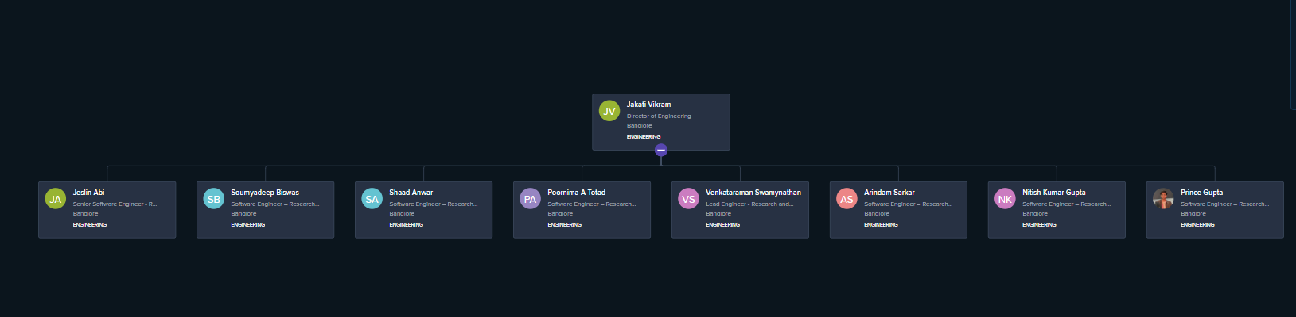
Tree Structure of Team

Slide 7
Challenges Faced in Internship
Regal as a product as lot of changes frequently which makes updating the Regal to the newer version a time-consuming process.
For every new release, lot of documentation must be read to develop new feature.
In my Team I am the only one who is working with Regal so If I encounter an Error, I should communicate with other Teams

Slide 8
Objectives of the work
Developing code for automation for testing environment using inhouse tools.
Developing MarketPlace Modules for Sales purposes
Create structured reports that aid in decision-making.

Slide 9
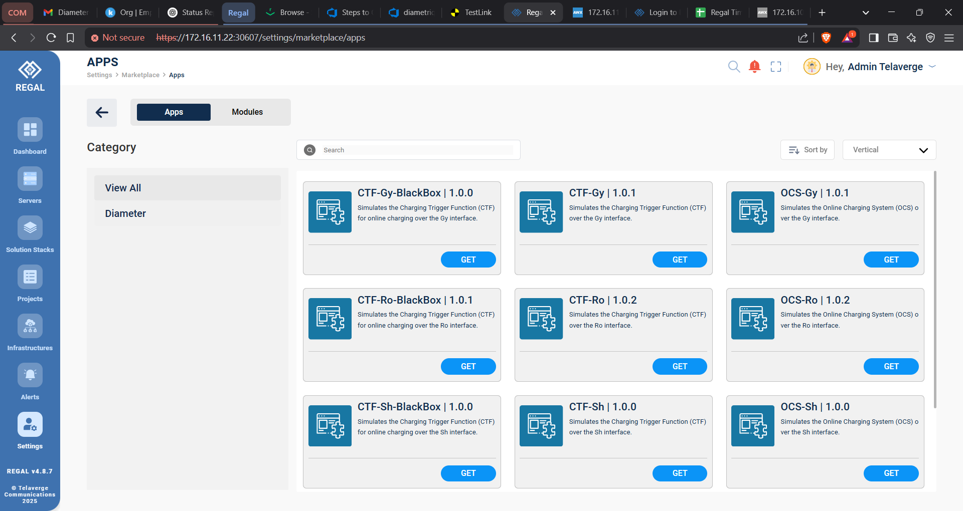

Slide 10
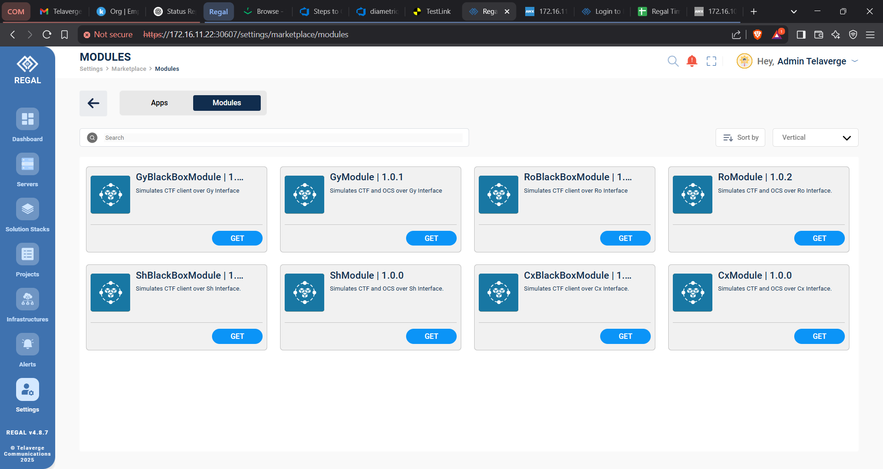

Slide 11
Proposed System / Work
Currently working on Developing Market Place modules for Function and Load Test Suts between CTF and OCS
Build Suts in legacy way
Test the code
Make rp and rtm fils for the working code
Upload the apps and modules to local market place
Test the apps and modules again
Finally Upload the Working module to Telaverge Marketpalce

Slide 12
Problem Statement
Write Code to Automate Testing for DiamonPro Binary Stack, DiaStack Binary and upload Working Suts to Marketplace.

Slide 13
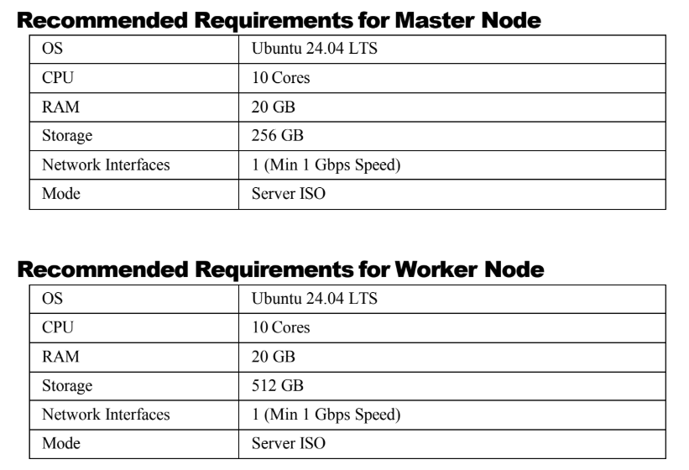
System Requirements

Slide 14
Internship Road Map
Note: Write in the below table what u will be achieving in each review
Review 0
Understand Team and Tools
Review 1
Working with The Interface and contributing to the Team
Review 2
Develop Automation Code for Diameter Stack
Review 3
Learn Cpp to Develop Feature for Diameter Stack

Slide 15
Github Link
https://github.com/princeo741/Software-Engineer-Intern-at-Telaverge.git

Slide 16
Q&A

Slide 17
Thank you !!

